Slide 1
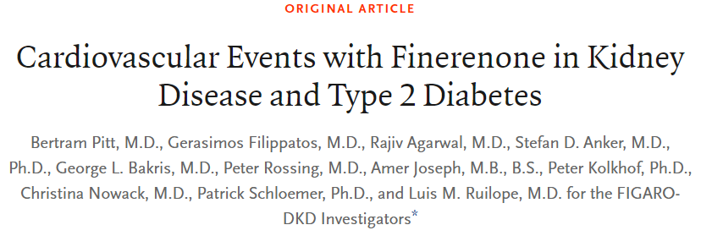
Presenter: Chia-Hsiang Kao (高家祥)
Supervisor: Fu-An Chen M.D. (陳甫安)

Slide 2
Take Home Message
Finerenone is a nonsteroidal, selective mineralocorticoid receptor antagonist.
Among patients with type 2 diabetes and stage 2 to 4 CKD with moderately elevated albuminuria or stage 1 or 2 CKD with severely elevated albuminuria, Finerenone therapy improved cardiovascular outcomes as compared with placebo.

Slide 3
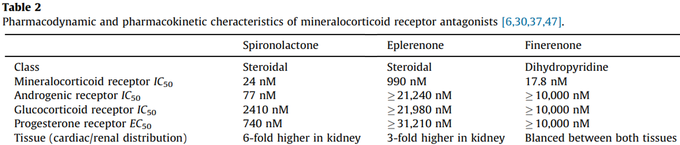
The Comparison of Spironolactone and Eplerenone
Spironolactone presents progestogenic and antiandrogenic activities.
- Produces sexual adverse effects, such as painful gynecomastia, painful enlargement of the breasts, loss of libido, impotence, and menstrual irregularities.
$$IC_{50}:\text{concentration} \text{required} \text{to} \text{inhibit}\text{ 50\% }\text{activation} \text{of} \text{the} \text{receptor}\text{.}$$
Ruilope, L. M., & Tamargo, J. (2017). Renin–angiotensin system blockade: Finerenone. Nephrologie & therapeutique, 13, S47-S53.

Slide 4
The Comparison of Spironolactone and Eplerenone
Spironolactone presents progestogenic and antiandrogenic activities.
- Produces sexual adverse effects, such as painful gynecomastia, painful enlargement of the breasts, loss of libido, impotence, and menstrual irregularities.
Eplerenone presents 20–40-fold lower affinity for the mineralocorticoid receptor.
- Less efficient in patients with hypertension or with primary hyperaldosteronism
$$IC_{50}:\text{concentration} \text{required} \text{to} \text{inhibit}\text{ 50\% }\text{activation} \text{of} \text{the} \text{receptor}\text{.}$$
Ruilope, L. M., & Tamargo, J. (2017). Renin–angiotensin system blockade: Finerenone. Nephrologie & therapeutique, 13, S47-S53.

Slide 5
What is Finerenone?
Finerenone has
high affinity for the mineralocorticoid receptor to Spironolactone.
high selectivity for the mineralocorticoid receptor as Eplerenone. (non-steroidal).
Besides, Finerenone is a full antagonist in different cell types, while Spironolactone and Eplerenone have partial agonistic activity in some receptors, leading to early-onset HTN in men and gestational HTN in women.
Ruilope, L. M., & Tamargo, J. (2017). Renin–angiotensin system blockade: Finerenone. Nephrologie & therapeutique, 13, S47-S53.

Slide 6
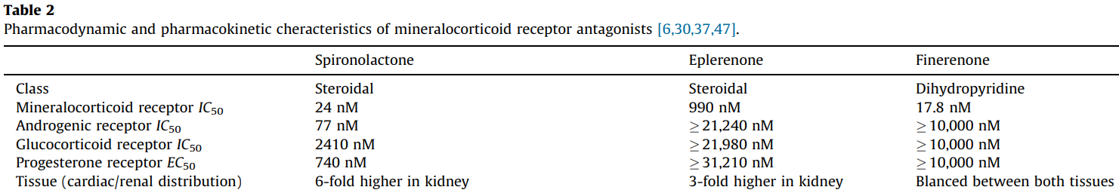
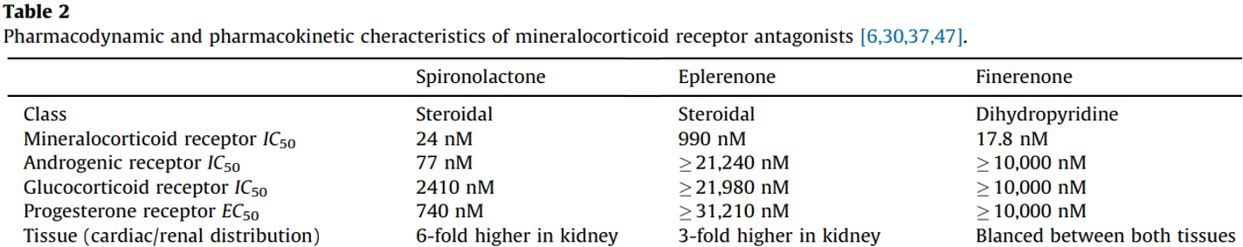

Slide 7
Research Question
Finerenone, a nonsteroidal, selective mineralocorticoid receptor antagonist, reduced albuminuria in short-term trials involving patients with chronic kidney disease (CKD) and type 2 diabetes.
Although previous trials have examined cardiovascular outcomes in patients with type 2 diabetes and varying degrees of CKD, there remains scant evidence from dedicated clinical trials to support the use of therapies to improve cardiorenal outcomes in patients with less-advanced CKD.
In other words, the long-term effects of Finerenone on kidney and cardiovascular outcomes are unknown.

Slide 8
Methods – Trial Design
Research type
Phase 3. Double-blind, randomized, placebo-controlled, multicenter clinical trial.
Patients
Inclusion of adults with T2DM and CKD.
Exclusion of patients who had symptomatic heart failure with a reduced ejection fraction.
In the run-in period, patients were treated with ACEi or ARB at maximum dose without unacceptable side effects.

Slide 9
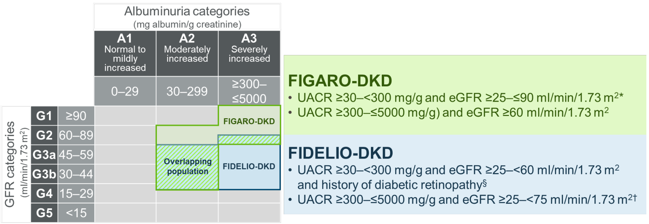
Methods – Trial Design
Patients
Adults with T2DM and CKD with two inclusion criteria.
✔
9

Slide 10
Methods – Trial Design
Patients
Adults with T2DM and CKD with two inclusion criteria.
Adults were treated with a renin– angiotensin system (RAS) inhibitor (ACEi or ARB) at the maximum dose on the manufacturer’s label that did not cause unacceptable side effects
10

Slide 11
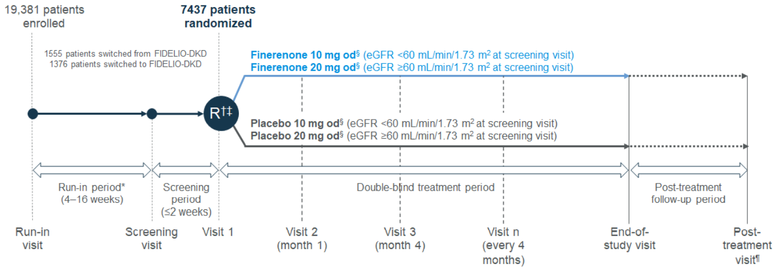
Methods – Trial Procedure
Maximal dose adjustment

Slide 12
Methods – Trial Procedure
Increase dosage (encouraged): From 10 to 20 mg once daily after 1 month, if serum potassium level was < 4.8 mEq.
Withdrawal: Finerenone or placebo was withheld if serum potassium level > 5.5 mEq and restarted when if it fell to 5.0 mEq or less.

Slide 13
Methods – Outcomes
Primary outcome:
Death from cardiovascular causes
Nonfatal myocardial infarction
Nonfatal stroke
Hospitalization for heart failure.
Secondary outcome:
Kidney failure (eGFR<15).
A sustained decrease of at least 40% in the eGFR from baseline over a period of at least 4 weeks
Death from renal causes.

Slide 14
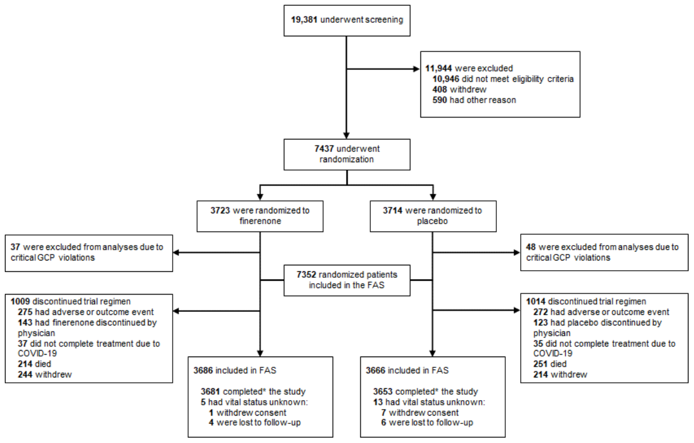
Results – Demographic and Clinical Characteristics
From 2015 to 2018, 13,911 patients in 48 countries underwent screening, and 5734 patients underwent randomization.

Slide 15
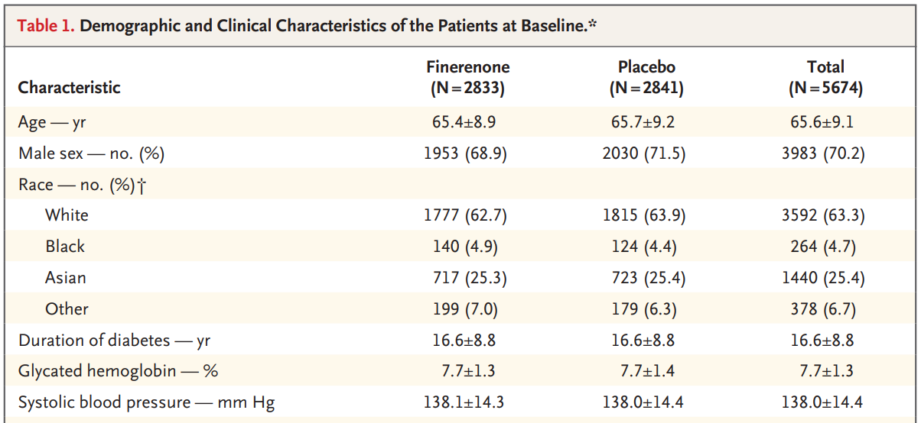
Results – Demographic and Clinical Characteristics

Slide 16
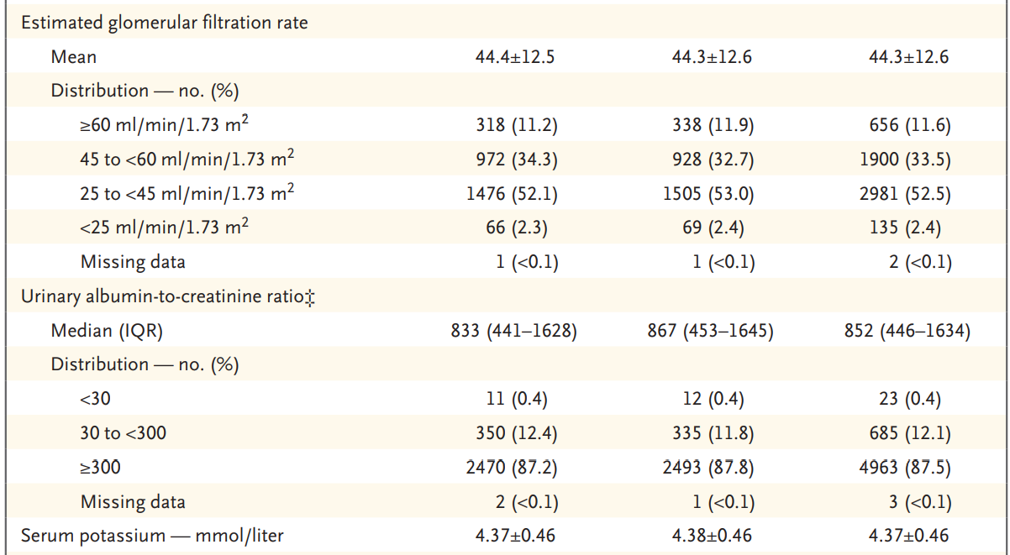

Slide 17
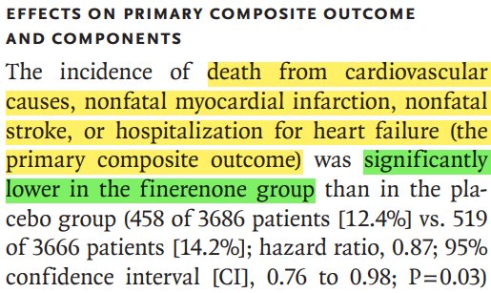
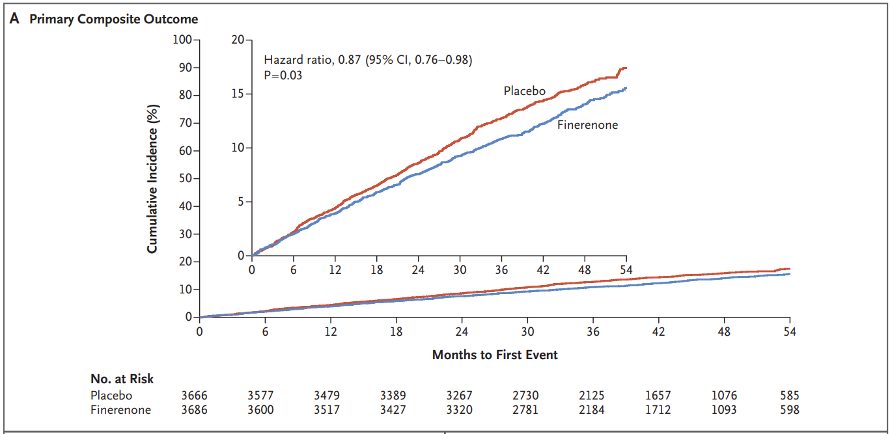
Results – Primary Outcome

Slide 18
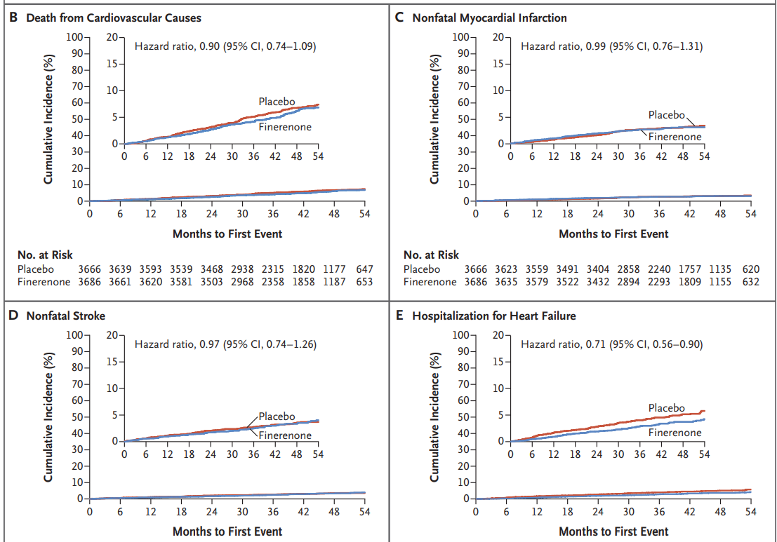
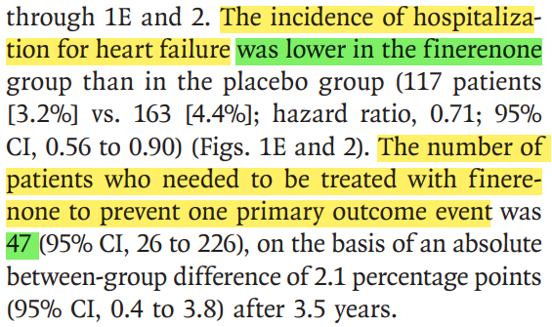
Results – Primary Outcome

Slide 19
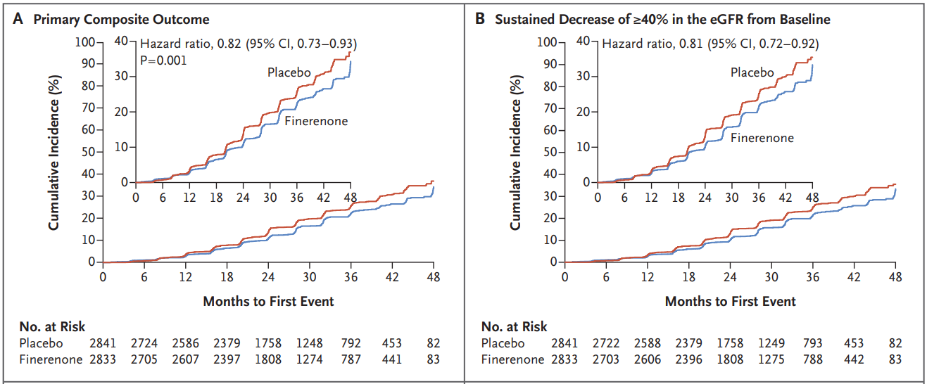
Results –Secondary Outcome

Slide 20
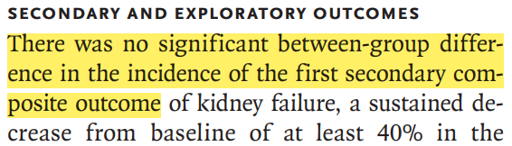
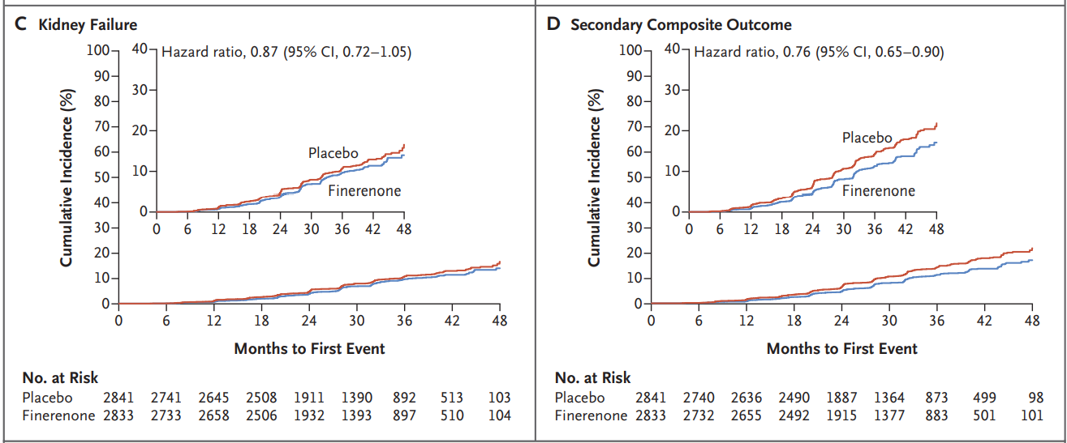
Results –Secondary Outcome

Slide 21
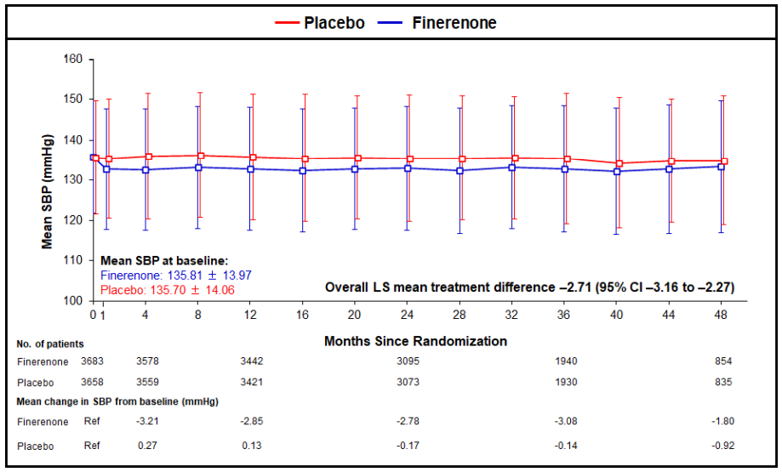
Results – Other Outcomes

Slide 22
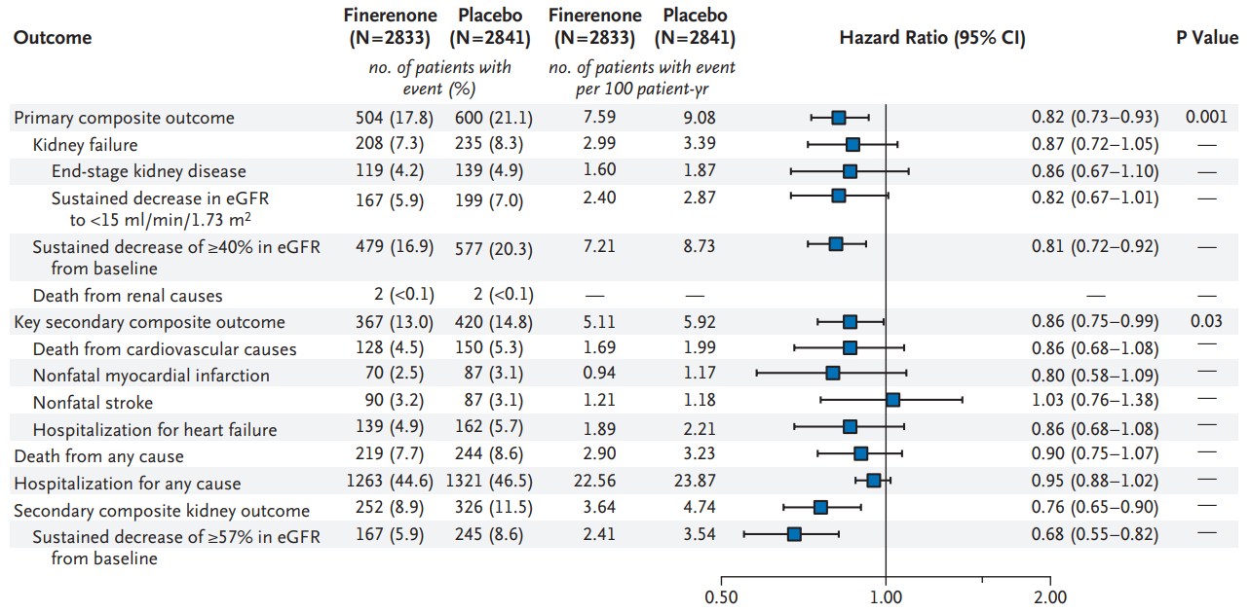
Results – Efficacy Outcomes

Slide 23
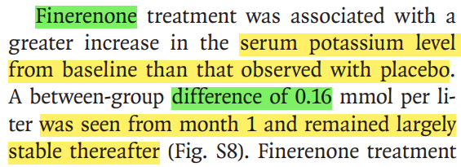
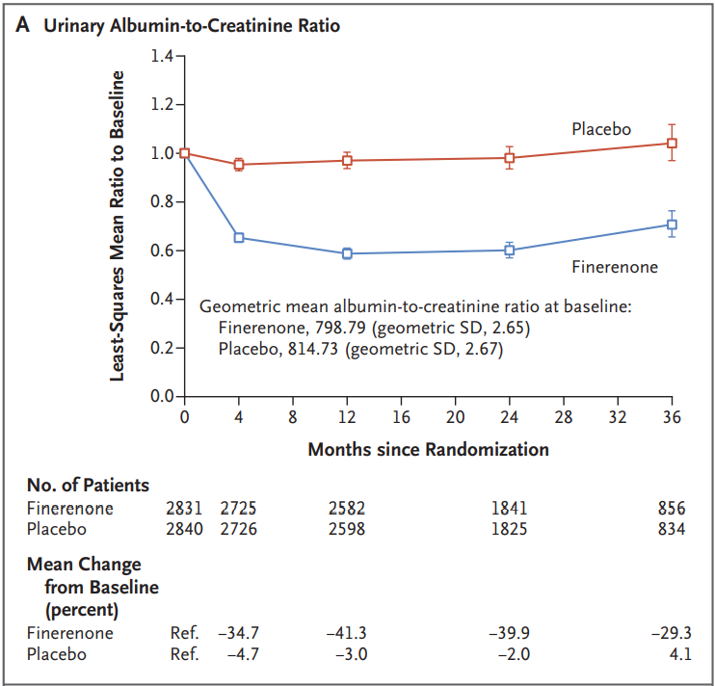
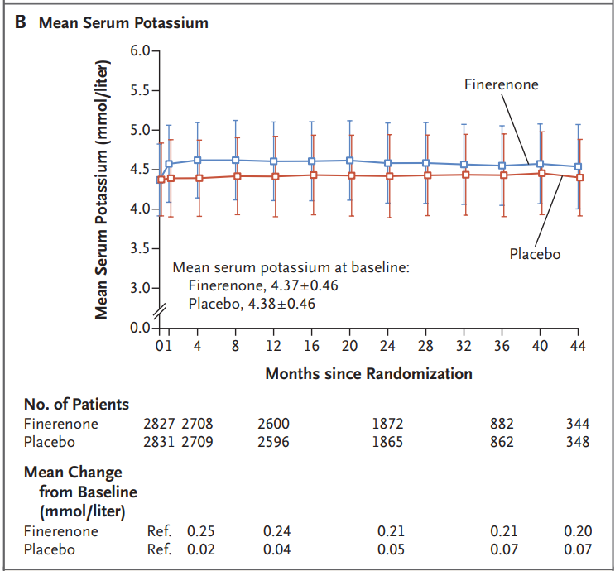
Results – Effects on Albuminuria and Serum Potassium
30.0%

Slide 24
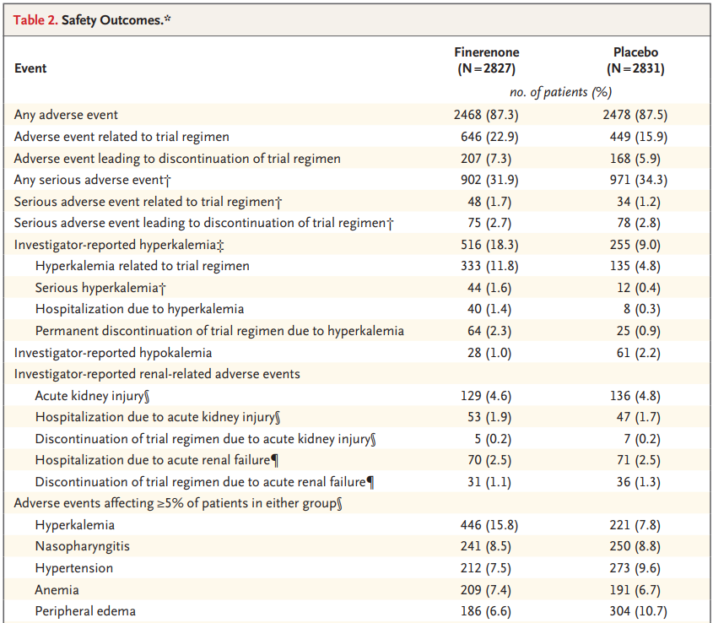
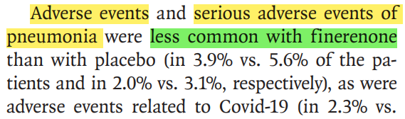
Results – Safety Outcomes.

Slide 25
Discussion - Early Stage and Late Stage Benefits
In this trial, the early reduction in albuminuria, early separation of the Kaplan–Meier curves for the key secondary outcome, and modest blood-pressure reduction suggest that some benefits of Finerenone may partly be mediated by natriuretic mechanisms.
Preclinical data showed that the kidney and cardiovascular benefits of Finerenone were associated with potent anti-inflammatory and anti-fibrotic effects through inhibition of overactivation of the mineralocorticoid receptor.
The delayed separation of the Kaplan–Meier curves for the primary outcome and persistent benefit over the trial duration provide evidence to support the hypothesis that Finerenone may slow CKD progression by influencing tissue remodeling.

Slide 26
Discussion - Limitations
Patients with non-albuminuric CKD and CKD not due to type 2 diabetes.
Only 4.7% of the participating patients identified themselves as Black.

Slide 27
Take Home Message
Finerenone is a nonsteroidal, selective mineralocorticoid receptor antagonist.
Among patients with type 2 diabetes and stage 2 to 4 CKD with moderately elevated albuminuria or stage 1 or 2 CKD with severely elevated albuminuria, Finerenone therapy improved cardiovascular outcomes as compared with placebo.

